Slide 1
ProtonAi LLm-based approach for question-answer automation
Team Details 11
Vishwas(20EG105411)
Abhinav(20EG105426)
Sai Chaitanya(20EG105437)
Project Supervisor
B. Ravinder Reddy
Assistant professor

Slide 2
Introduction
Our project mainly focuses on enhancing traditional question and answer interactions using Generative AI​
This is basically an educational platform created for university level students as all courses aren't available in other platforms.​
This model uses textbook data provided by user rather than Wikidata (Wikipedia data).​
Question and answer can be generated for desired courses.​
Our approach relies on Large Language Models (LLMs), Natural Language Processing (NLP), and the Generative Pre-trained Transformer (GPT).​
Our system seamlessly integrates these technologies, creating a robust architecture for understanding and responding to user queries.​

Slide 3
Problem Statement
The existing algorithm uses the longtail knowledge that is the wikideta (Wikipedia data) to answer the users queries and also there are other algorithms which does the open domain question answering but the problem arises when it comes to the educational use case where the student as a user cannot accurately retrieve the answers from the gpt models because of the lack of text-book that is theoretical knowledge present. So, as to overcome this problem we came up with a solution where we powered our protonai with the latest algorithm which searches the given knowledge base and retrieves the answers for the students query.

Slide 4
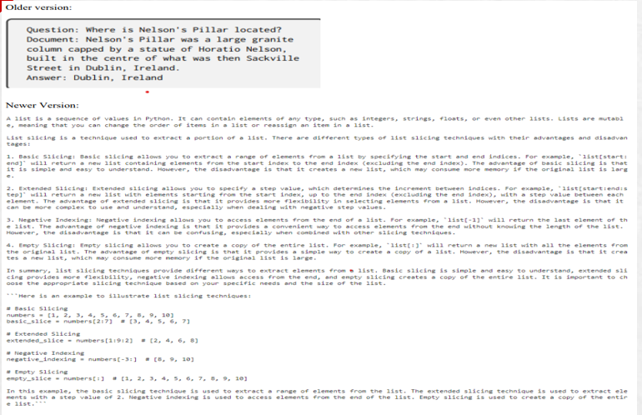
Problem Illustration
Let's denote:P as the given passage.Q as the input question.The task is to design a model M such that M(P,Q) returns the answer to the question Q based on the information in the passage
P.
M(P,Q)→Answer

Slide 5
Proposed Method
Meet Protonai, my brainchild! It's not just your average question-answering AI. Forget clunky rule-based systems - Protonai harnesses the power of both GPT's fluency and Langchain's meticulous fact-checking. Imagine a generative AI that understands context, seamlessly blends factual accuracy with natural language, and even learns from every interaction. That's Protonai - your friendly, knowledge-powered conversationalist, ready to tackle any query with insightful answers and a dash of AI magic.
Beyond the impressive parameters of Langchain and GPT, Protonai 's true magic lies in its focus on student needs. While these existing algorithms excel at navigating the vast oceans of general knowledge like Wikipedia's depths, they often flounder when it comes to the specific shores of your textbook. Protonai bridges this gap. It dives deep into your assigned materials, understanding the context and nuances of your subject. Langchain's knowledge chains become intricate pathways through your textbook's concepts, while GPT's fluency translates them into clear, subject-relevant answers. Every interaction strengthens Protonai 's grasp of your curriculum, tailoring its responses to your specific learning journey. Forget generic summaries and lost connections –Protonaibecomes your personalized study buddy, unlocking the power of your textbooks and guiding you towards deeper understanding.

Slide 6
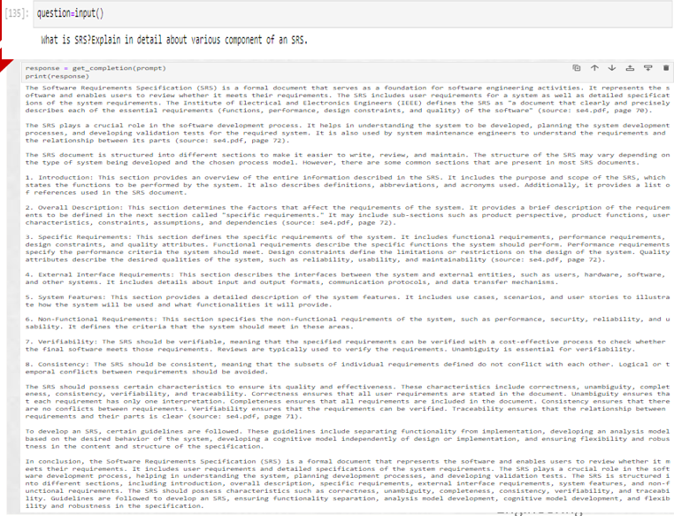
Proposed Method
Let:
- Q be the user's question.
- T be the set of textbooks in PDF format.
- M be your GPT model.
Input Processing:
Q is the user's question.
Textbook Analysis:
Identify relevant sections in textbooks:
S=MarkRelevantSections(T,Q)
Knowledge Retrieval:
Extract information from textbooks using GPT: I=ExtractInformation(M,S,Q)
Answer Generation:
Synthesize answers:
A=GenerateAnswer(M,I)
User Interaction:
Present the generated answer: Output=PresentAnswer(A)
:

Slide 7
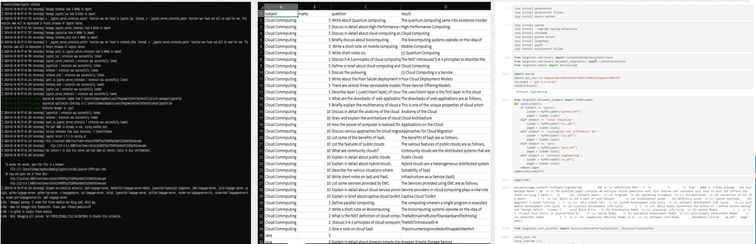
Experiment Environment
Tool: Jupyter Notebook
Language: Python
Dataset: csv – json line data set

Slide 8
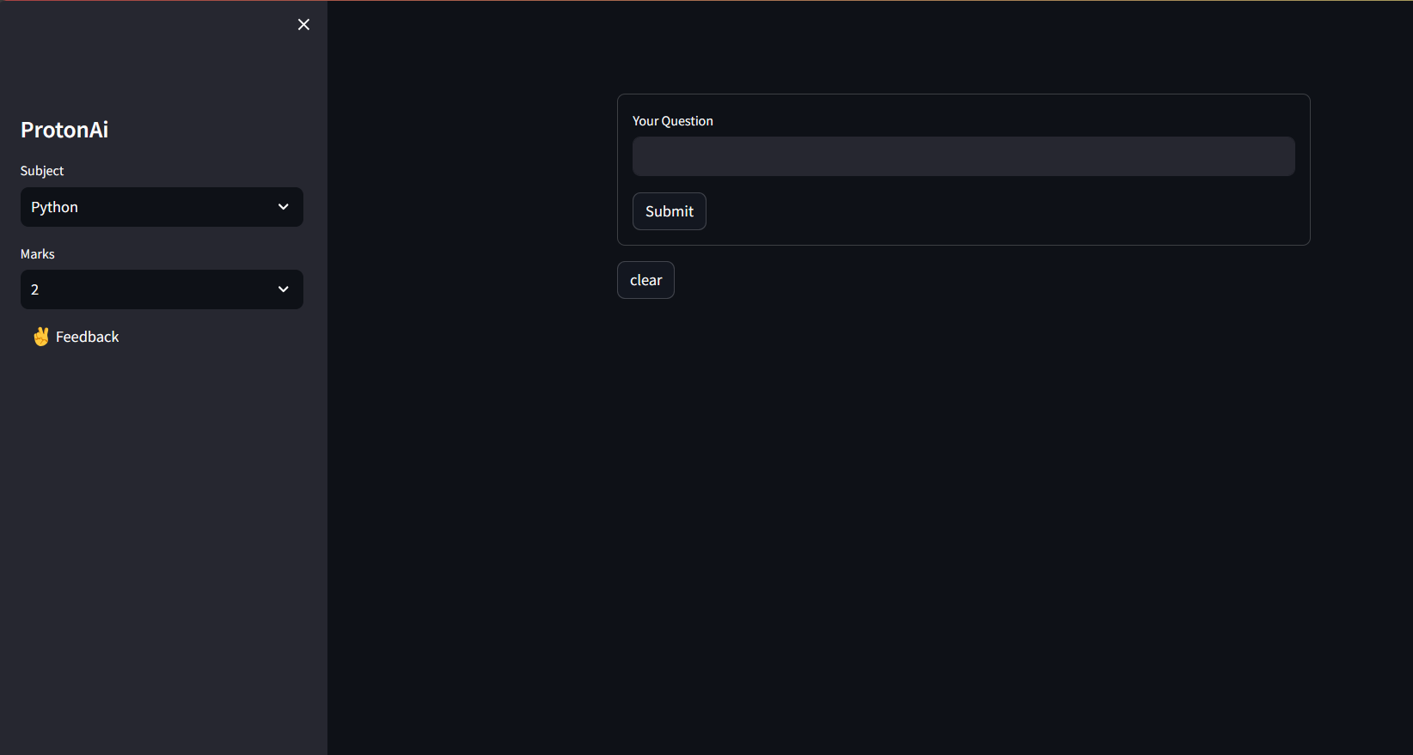
Experiment Screen shorts
User Input
Subject Input
Marks Input

Slide 9
Experiment Results
precision - 0.72
recall score - 0.88
BLEU Score: 0.9719851781324025
rouge 1 - 0.91
rouge 2 - 0.89
rouge L - 0.91
The analysis suggests the proposed summarization method shines based on the BLEU and ROGUE scores. These scores reflects how well summaries capture key terms from reference summaries. The higher the score, the better. Here, the proposed method boasts the highest BLEU score (0.95) and ROGUE scores, outperforming other techniques. This indicates it excels at including the most important words in the summaries. While these scores are valuable, it doesn't guarantee perfect summaries. Human evaluation is still crucial for a well-rounded assessment.

Slide 10
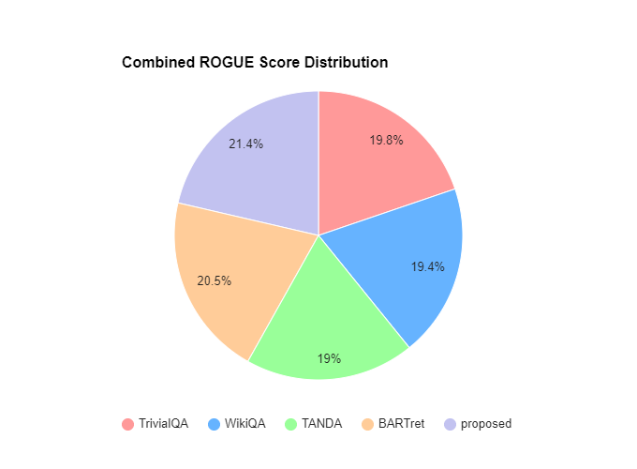
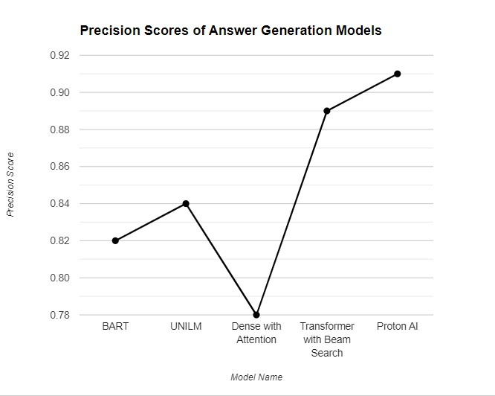
Experiment Results

Slide 11
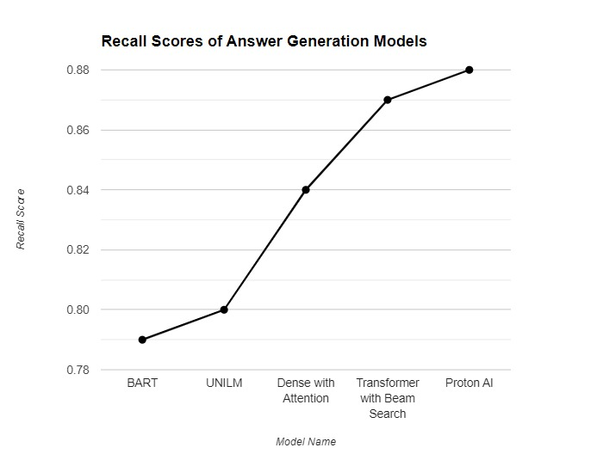
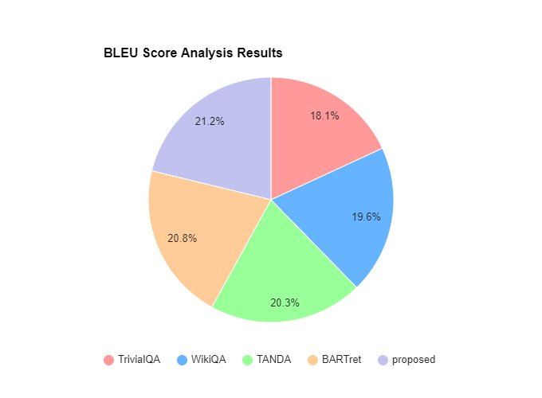
Experiment Results

Slide 12
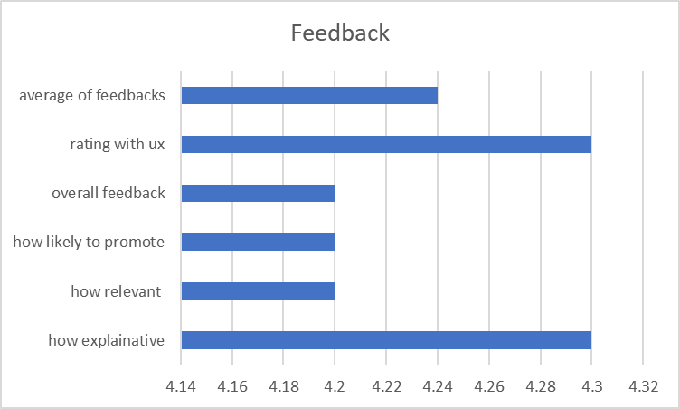
Experiment Results
When seen the figure above it clearly tell that users who used the model when given access seem to be greatly satisfied with the results that protonAi has generated, showing that proposed method excels in its task when compared to the previous methods.

Slide 13
Finding
The proposed method effectively generated responses as per user convenience.
Proton ai effectively summarizes from all the documents and provide a meaningful answer
It provides answer which is relevant to the textbook data making easy for students.
The user interface is quite user friendly and doesn't need any resources apart from internet.
All the parameters of the proposed model are greater than the existing model, which makes it better.

Slide 14

Justification
Parameters | Mathematical formula | Existing value | Improved value | Justification
Recall score |  | 0.89 | 0.91 | Proton ai is trained using GPT 3.5 which makes it efficient.
BLEU Score |  | 0.88 | 0.95 | Similarity search helps in summarizing more content and producing relevant answer
ROGUE score |  | 0.84 | 0.92 | OpenAi embeddings and all other tools helps in increase of overall accuracy of the answer

Slide 15
Thank you 😁

